Slide 1
Email Campaign
Cindy Huang

Slide 2
E-Mail Marketing Campaign Performance Tracking https://github.com/yuanhsin8311/email-marketing-campaign

Slide 3
E-Mail channel conversion experiment (AB Test)
Define “Click-and-Convert to apply Loan” as KPI
Question: time-limited sales pitch in subject line can get more conversion?
Determine sample size based on 0.05 significance level, minimum effect size, power, expected standard deviation of the change in metric
Based on sample size, the number of days to run AB test is confirmed
Do Cohort Analysis to narrow down sample size scope
- Focus on 30 years, joint account, family income > $200K
- Home Mortgage fixed 30y 4.609% email campaign
Randomly split this groups as control and treatment group
Run t-test and use p-value to verify the difference between two versions
Cost analysis if the changes are worth to follow up

Slide 4
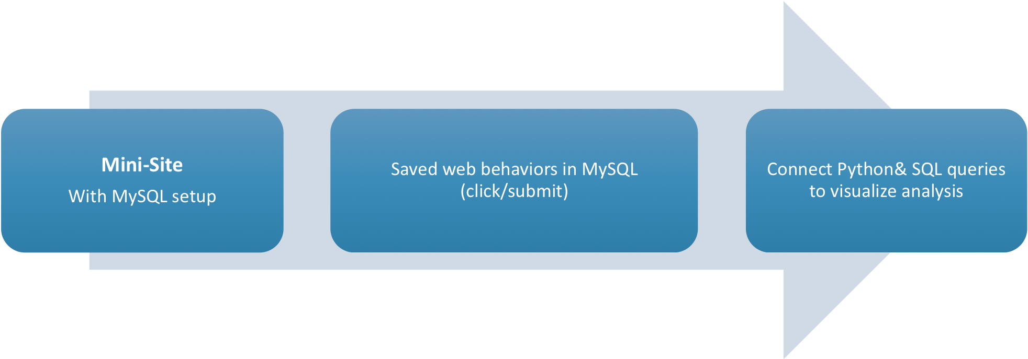
Get Data Workflow

Slide 5
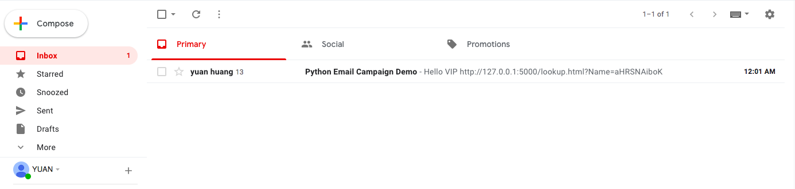
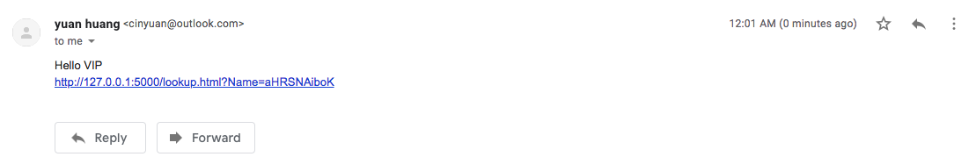
E-Mail Campaign Simulation: Send mails to TA via Python scripts

Slide 6
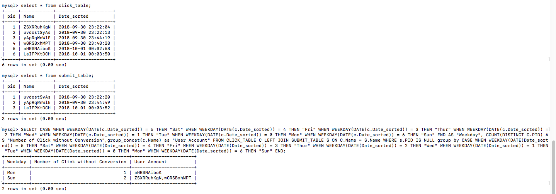
Get TA who clicked but didn’t apply loan (MySQL)

Slide 7
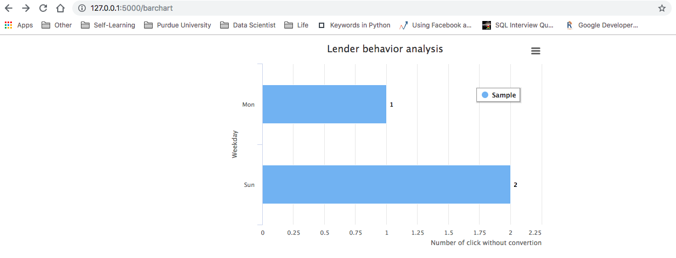
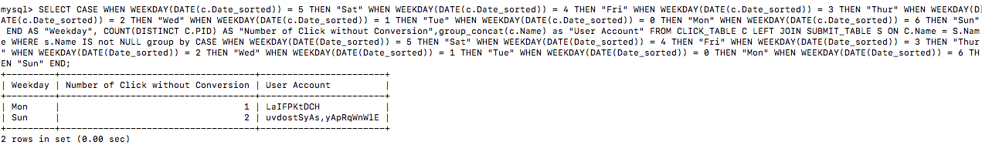
TA who clicked and were converted

Slide 8
Thank You

